Slide 1

KOMFORT

Slide 2
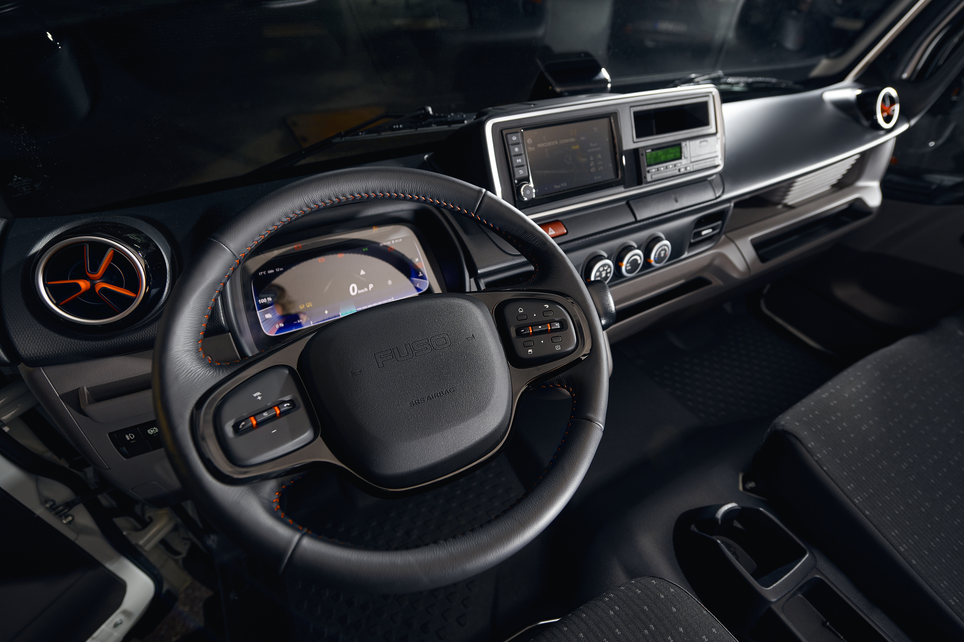
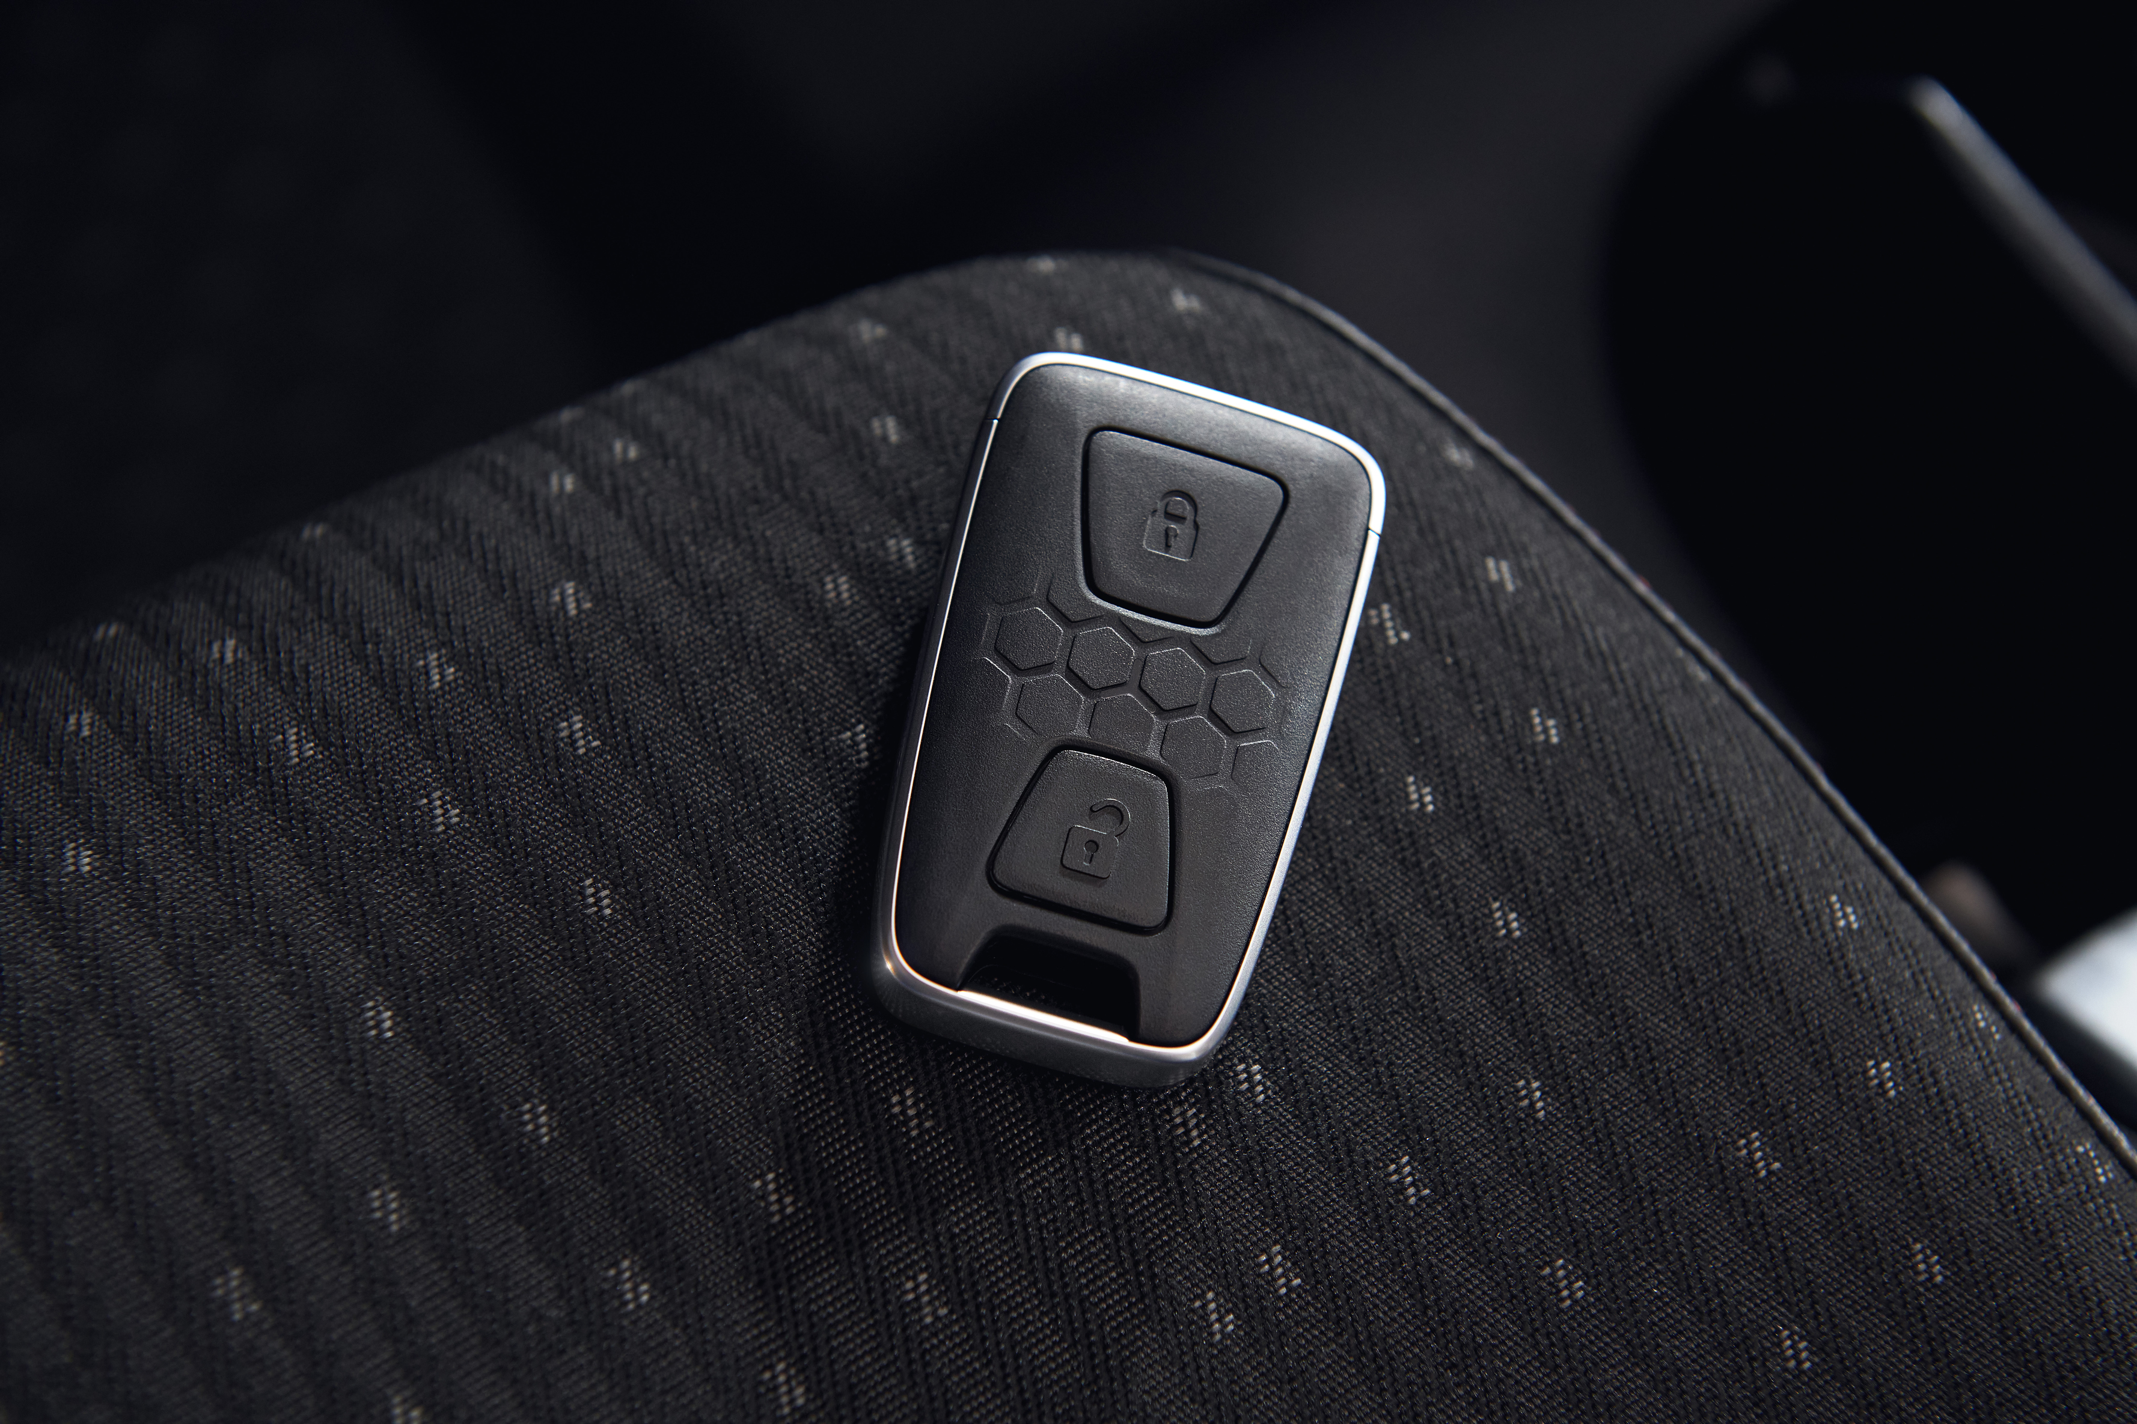
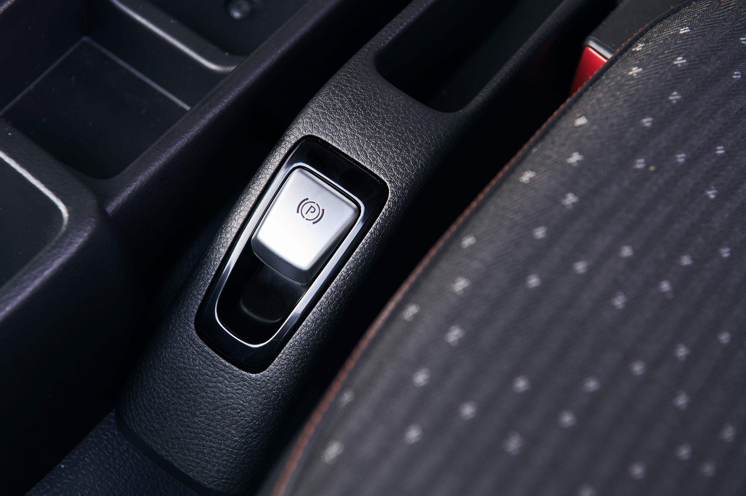
ELEKTRICKÁ JAZDA S eCANTER JE POHODLNÁ
INTERIÉR ORIENTOVANÝ NA VODIČA
DIGITÁLNA PRÍSTROJOVÁ DOSKA
SMART KEY
ELEKTR. PARKOVACIA BRZDA
Notes:
With eCanter NG – FUSO introduces a new interior including multiple features, oriented for the driver:
Digital LCD instrument cluster for easier view, with speedometer, odometer, battery level indicator, recuperation level indicator, blind spot warning, and others
Multifunction steering wheel to operate the Dashboard and all functionalities without taking off the hands from the steering wheel
Smart Key system to open the vehicle. Engine Start-Stop button to start or stop the vehicle I makes it easier in stop-and-go traffic to get back driving quickly without turning a key
Electric Parking Brake (ePB): Effortless operation at a touch of a button, Linked with “P” button on shift lever

Slide 3
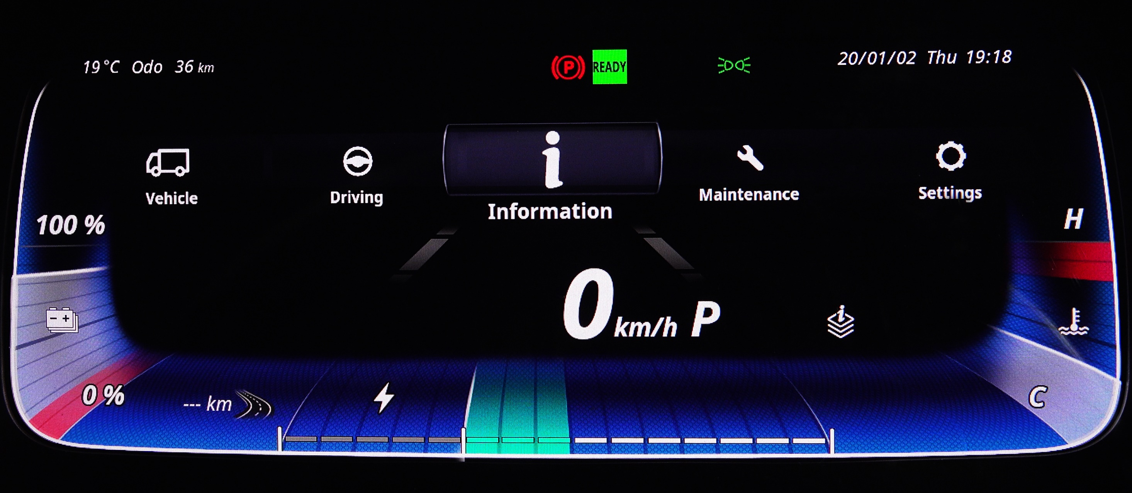
ELEKTRICKÁ JAZDA S eCANTER JE KOMFORTNÁ
DIGITÁLNY LCD PANEL
Notes:
In-Plane Switching (IPS) LCD panel:
Outstanding color accuracy, allowing display of eye-catching graphics
Extremely wide viewing angles both horizontally and vertically, ensuring drivers of different heights can view the dashboard easily
Superior sunlight visibility, assuring readability even under bright sunlight
Longer lifespan than other LCDs, thus minimizing downtime for replacement
Unique, eye-catching graphics
User-friendly layout

Slide 4
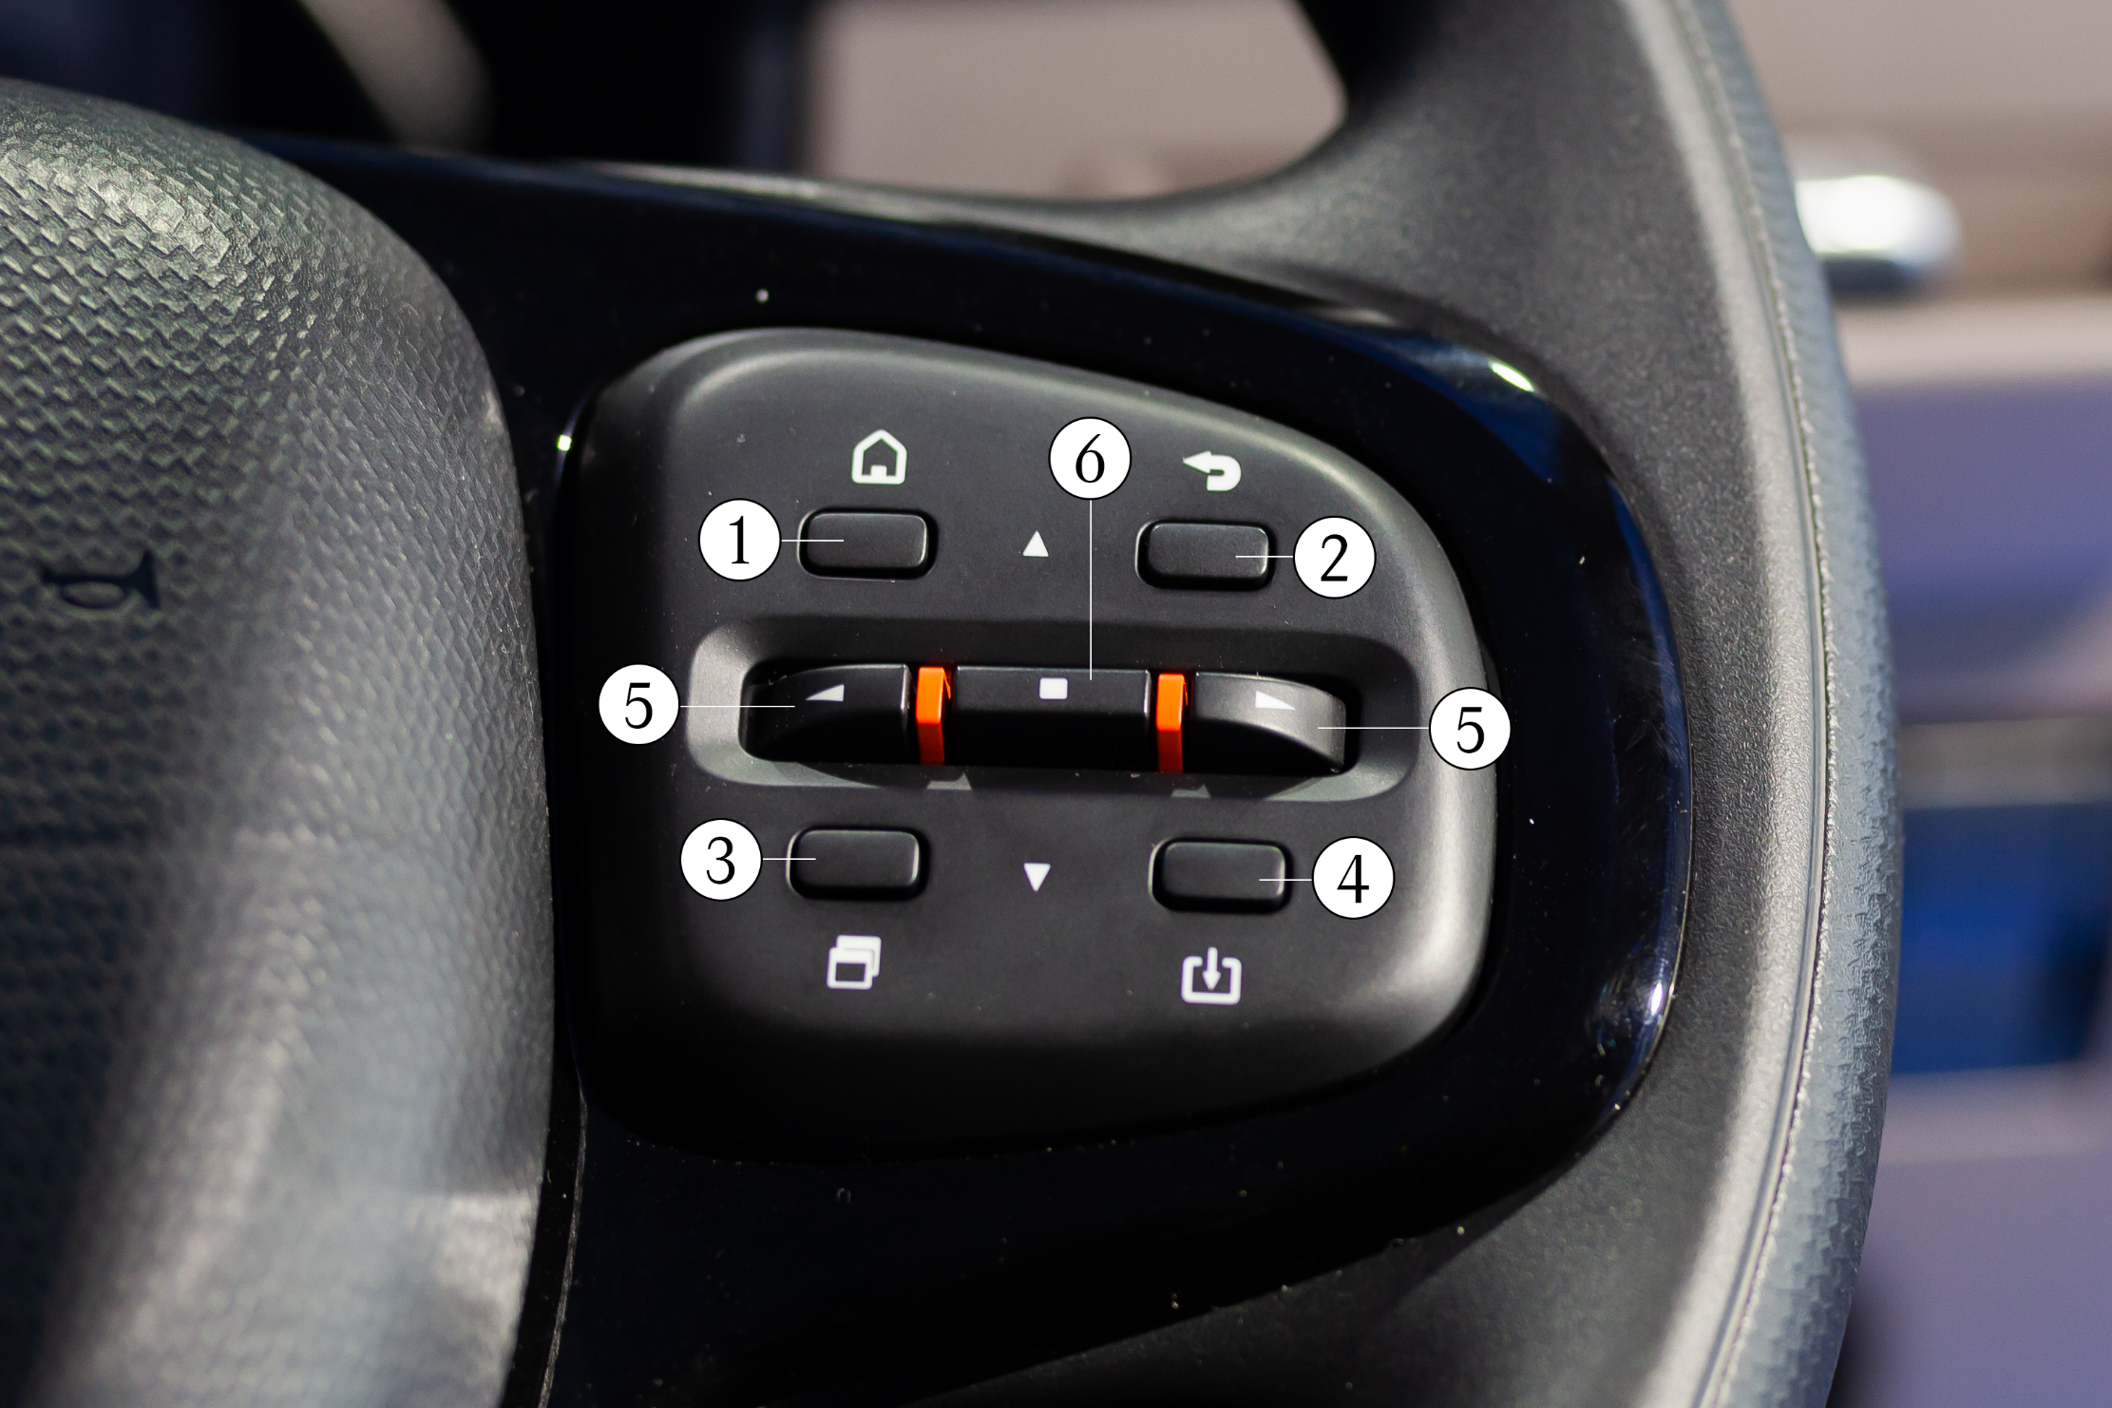
ELEKTRICKÁ JAZDA S eCANTER JE KOMFORTNÁ
INTUITÍVNY KONCEPT OVLÁDANIA
Single-speed and no gear change or clutch operation required
No gearshift interruptions
Quiet, smooth, nimble driving, and better ride comfort
a plus in comfort for all drivers
1
Tlačidlo „Home“ – návrat na hlavnú stránku
2
Tlačidlo „Return“ – návrat na predchádzajúcu úroveň
6
1
2
3
Rýchle menu
5
5
4
Tlačidlo „Memory“
3
4
5
Pravé/ľavé tlačidlo
6
Tlačidlo výberu
Notes:
We often face changing drivers in commercial vehicle operations – the NG eCanter provides a simple and intuitive operating concept with a new multifunction steering wheel
New drivers quickly familiarize with the system
Home switch: To return to the normal screen
Return switch: To return to the previous screen or main menu
Quick Menu switch: To show the quick menu
Memory switch:
To recall the screen registered as a favorite
To register the current screen as a favorite (press & hold)
Left/Right switches: To move to the left/right item
Selector switch:
To display the main menu or select an item (press)
To move to the above/below item (flip up/down)

Slide 5
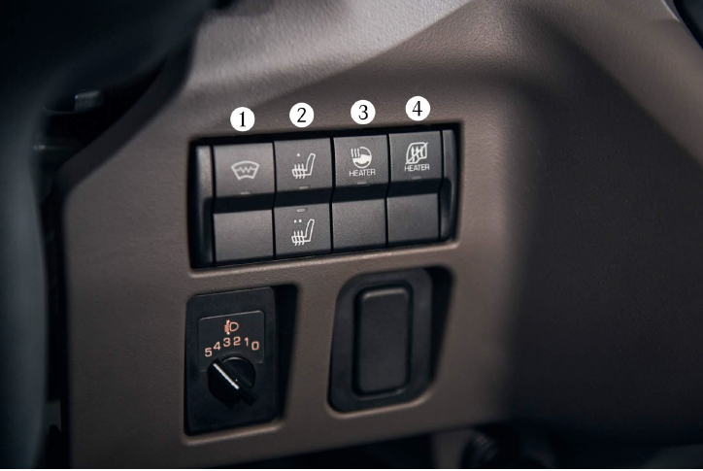
ELEKTRICKÁ JAZDA S eCANTER JE KOMFORTNÁ
Ohrev kabíny – komplexný balíček
FEATURES
1
Ohrev čelného skla
1
2
3
4
2
Ohrev sedadla vodiča
3
Ohrev volantu
4
PTC vypnutie ohrevu
Predĺženie jazdy až o 20%
Notes:
Combining comfort features with efficiency – the new optional eCanter Cab Heating Performance Improvement package
For additional comfort the NG eCanter comes with the following optional features:
Front windshield heater
Driver seat heating
Steering wheel heating
Can be combined as a packed
Especially in winter, those features a a comfort plus for all driver‘s
Especially the steering wheel heating is very popular as usually hands are coldest
But, those features are not only for comfort – they are a key aspect also for the vehicle efficiency!
The NG eCanter has a PTC (positive temperature coefficient) heating system which is safe and efficient
However, when power is first applied to the cold PTC heating element, it has a low resistance and draws a larga amount of current, which has of course effect on battery range
The previously mentioned features are an important aspect in cold temperatures to increase efficiency, as those consume a lot less energy
For reference:
The PTC heating system consumes up to 6.8kW at peak in very low temperatures below zero degrees
In comparison:
Steering wheel heater only 80W (that is 80x less)
Heated driver seat (60W on high, 15W on low)
Heated front windshield (1200W)
We calculated that when the driver turns off the PTC heating system, using the above mentioned features instead, the driving range can increase by up to 20%.
By using these tools, you are not at disadvantage in Winter and can use eCanter as in Summer
→ Especially when you are entering and leaving the vehicle frequently

Slide 6
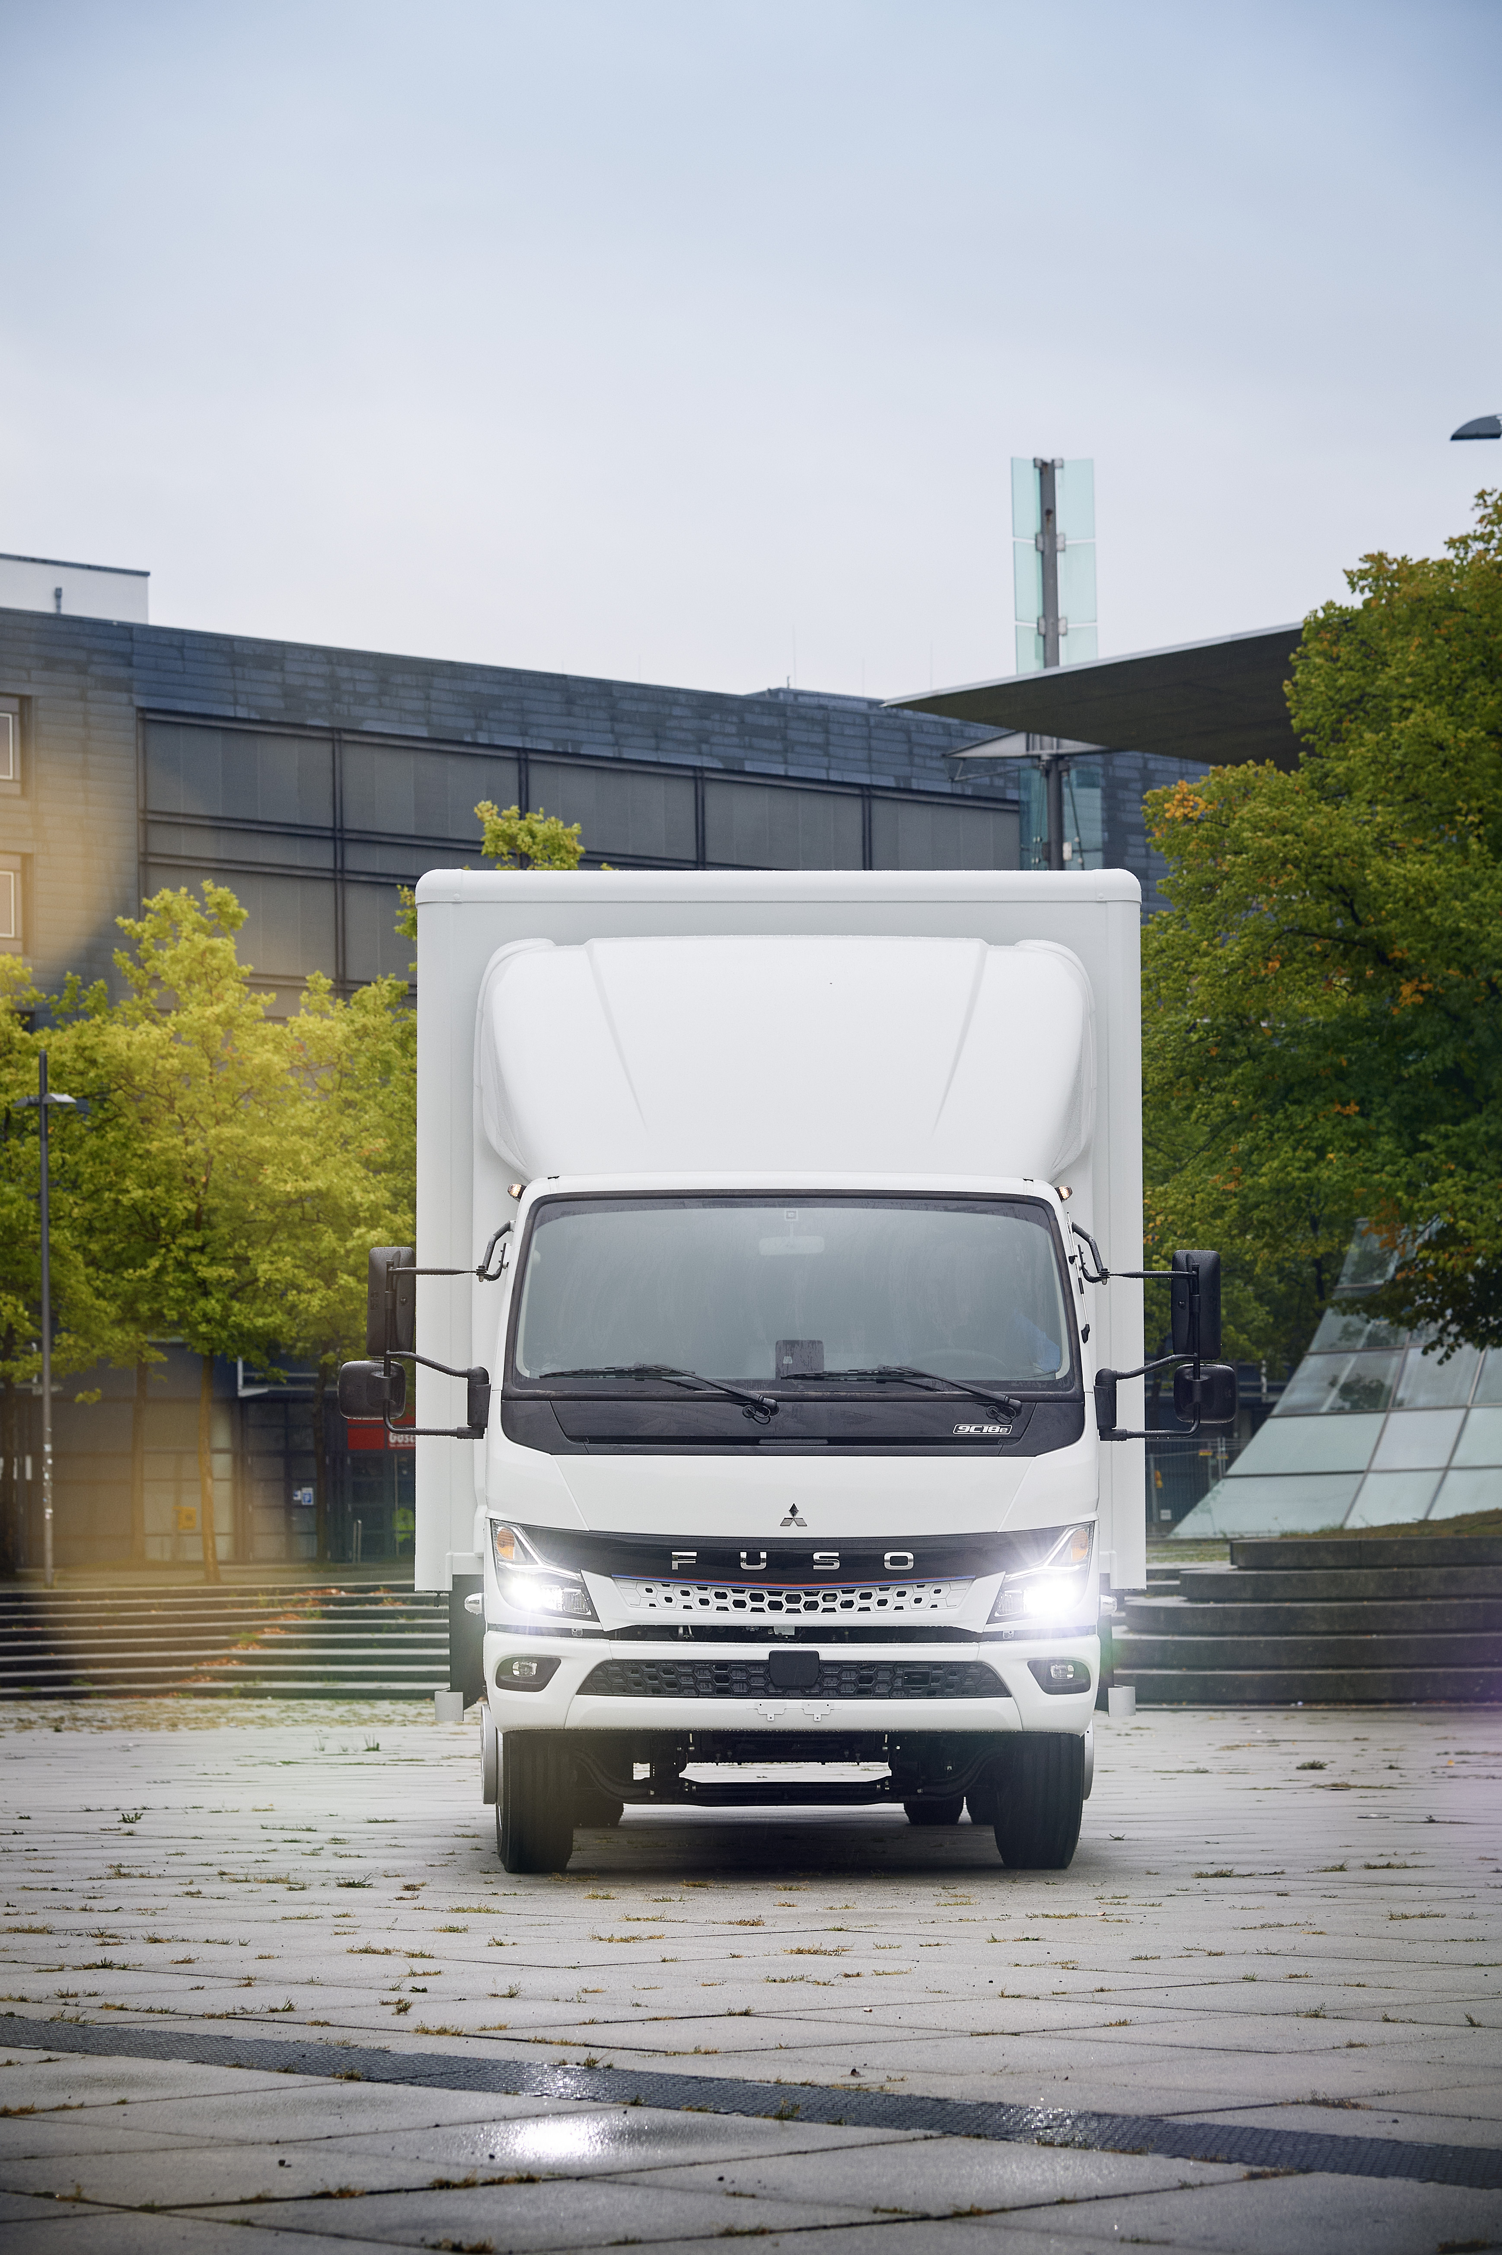
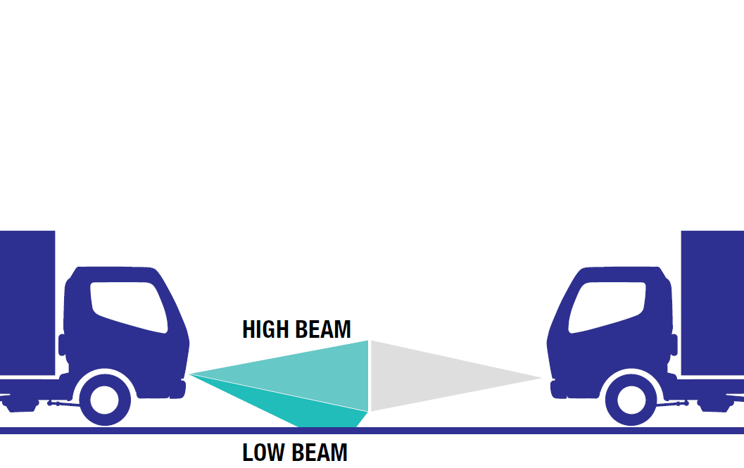
ELEKTRICKÁ JAZDA S eCANTER JE KOMFORTNÁ
Inteligentná kontrola osvetlenia vozidla
Inteligentná kontrola osvetlenia (IHC) prepína automaticky medzi nízkym a vysokým svetelným lúčom hlavných svetlometov v závislosti od vonkajších svetelných podmienok, od prichádzajúcich vozidiel a iných faktorov.
Komfort & bezpečnosť vodiča
Notes:
Intelligent Headlight Control (IHC) automatically switches the headlamps between high beam and
low beam according to the brightness of the surroundings, oncoming vehicles, and other factors.
Additional safety and comfort for the driver when driving in dark surroundings, e.g in between cities with regular counter traffic.

Slide 7
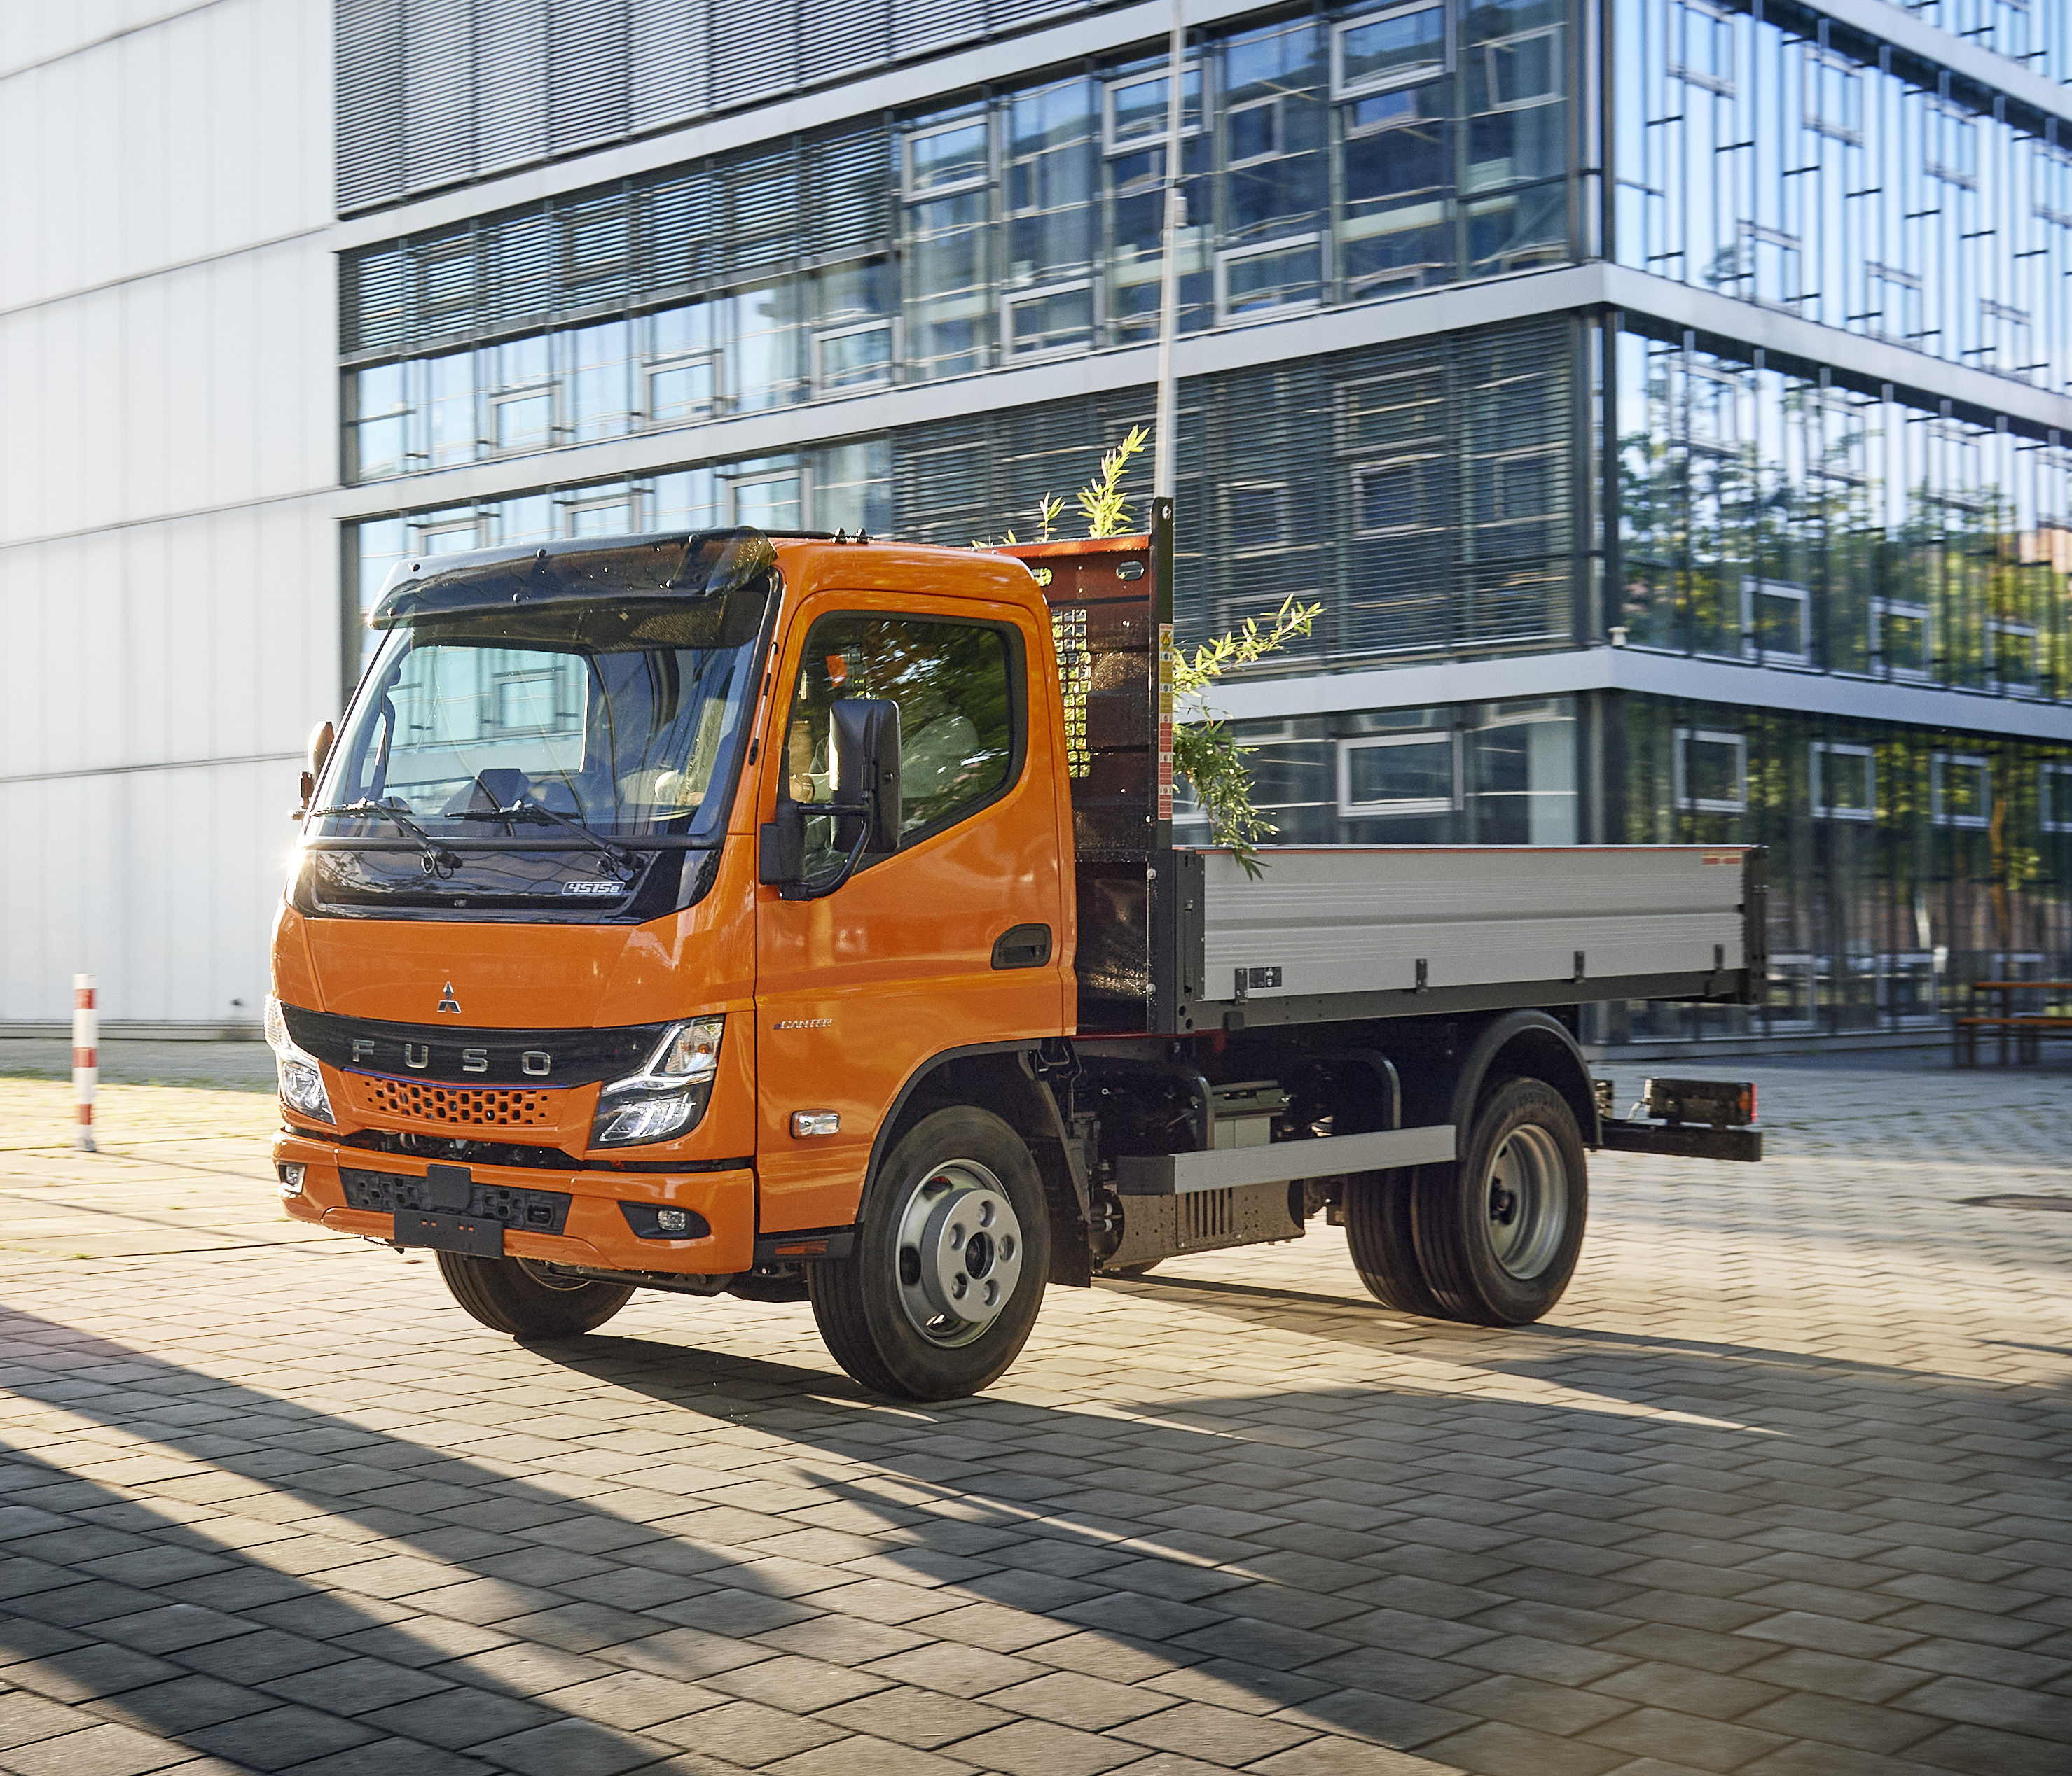
ELEKTRICKÁ JAZDA S eCANTER JE KOMFORTNÁ
Nízka úroveň hluku
2x tichší!
1
Vnútorný hluk (dB)
Rýchlosť | NG eCanter | Diesel Canter
20 km/h | 52.5 | 56.4
40 km/h | 55.5 | 59.2
60 km/h | 62.0 | 66.1
80 km/h | 67.4 | 70.7
4x tichší!
2
Externý hluk pri prejazde (dB)
Rýchlosť | NG eCanter | Diesel Canter
50 km/h | 67.8 | 73.7
Notes:
Noise is an important aspect of well-being, not only when driving
With eCanter – we made the next step in terms of noise improvement of the vehicle; not only compared to the combustion engine vehicle, but also compared to the previous eCanter generation
Interior noise:
At average inner-city speed of 40 km/h the NG eCanter is 3.7 dB more silent than the comparable Diesel truck
3.7 dB does not seem much at first glance
However, a 3dB sound decrease means the sound energy is halved!
So the interior noise perception for the driver of an eCanter NG is half of that of a Diesel truck
Additionally there are less vibrations
In total This is a huge comfort plus and reduces driver fatigue and stress
2) Exterior noise:
The impact on the exterior noise is not minor impressive
NG eCanter is about 6 db more silent I equating to a factor of 4-less than the Diesel reference

Slide 8
Výkon

Slide 9
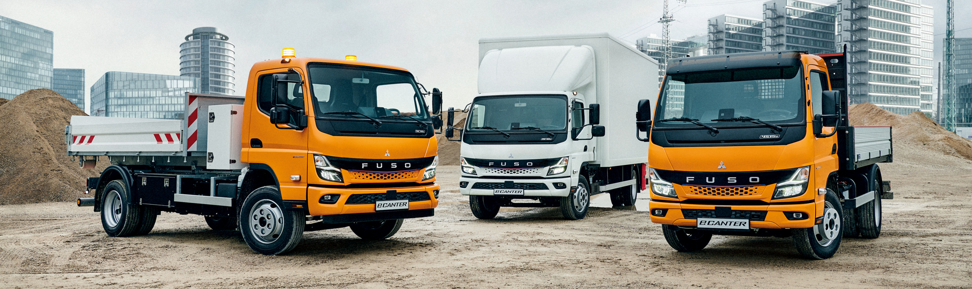
ELEKTRICKÁ JAZDA S eCANTER JE HRAČKOU
VÝKON
FUSO ponúka 2 silné a vysoko efektívne eMotoré varianty:
eCANTER 4.25t + 6.0t
430 Nm/ 110kW (max.) & 250 Nm/85kW (trvale)
eCANTER 7.49t + 8.55t
430 Nm/ 129kW (max.) & 250 Nm/110kW (trvale)

Slide 10
Efektívnosť

Slide 11
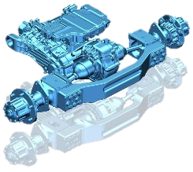
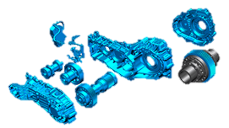
ELEKTRICKÁ JAZDA S eCANTER JE EFEKTÍVNA
E-náprava s jednorýchlostným prevodom
Jeden prevod bez prevodovky a spojky
Konštantný záber bez prerušenie ťahu
Tichý, hladký a svižný chod vozidla, zlepšený komfort jazdy
Notes:
Another element that makes the NG eCanter comfortable, but also efficient is the eAxle with single-speed transmission
Why does the eCanter, compared to Diesel Canter have direct drive – single speed transmission?
In General:
Gearboxes fundamentally fulfil the following 3 tasks:
Power transmission (connects the motor with the drive drain)
Influencing the direction of rotation.
Control of the speed and torque.
In comparison to electric motors, combustion engines have a comparably low torque in the lower speed range.
Without a gearbox, this would result in insufficient power transmission for starting, acceleration, and ascents.
However for efficient driving with in higher rolling speed you then need to switch to higher speed, lower torque ratio
Why can we operate the eCanter with direct drive I single-speed transmission?
Based on the nature of the electric motor and eDM unit in eCanter
Compared to a combustion engine, the electric motor already has full torque available on starting, almost independently of the speed
The eCanter can do 15.000 rpm vs. 3800 peak rpm (revolutions per minute) for the same 129kW Diesel engine on Canter
Because we do not have gearshift and also no propeller shaft, we also have higher efficiency

Slide 12
ELEKTRICKÁ JAZDA S eCANTER JE EFEKTÍVNA
4 stupne rekuperačného brzdenia
Stupeň | Brzdná sila
B0 | Bez rekuperačného brzdenia - “Sailing”
B1 | Brzdná sila ekvivalentná k brzdeniu motorom (Diesel Canter)
B2 | Brzdná sila ekvivalentná k brzdeniu motorovou brzdou (50 kW Diesel Canter)
B3 | Silnejšia brzdná sila ako motorová brzda ( viac ako 50 kW Diesel Canter)
Odporúčané nastavenie
Notes:
4 modes I to be chosen individually depending on road conditions, driving style

Slide 13
ELEKTRICKÁ JAZDA S eCANTER JE EFEKTÍVNA
4 stupne rekuperačného brzdenia
Stav brzdenia
Aktuálny stupeň rekuperačného brzdenia
Powermeter
Výkon elektr. motora
1
2
ECO zóna
3
2
1
3
Nabíjacia - rekuperačná zóna
Notes:
The power meter displays the output of the electric motor and the status of regeneration
Zone 2 + 1 both mean there is electrical motor output -> represents that the high voltage lithium-ion batteries are being used by the motor to produce output and drive the vehicle
Zone 2 is ecozone > economical driving zone
Zone 3 is the charge zone -> this represents that the high-voltage lithium-ion batteries are being charged by the regenerative braking system

Slide 14
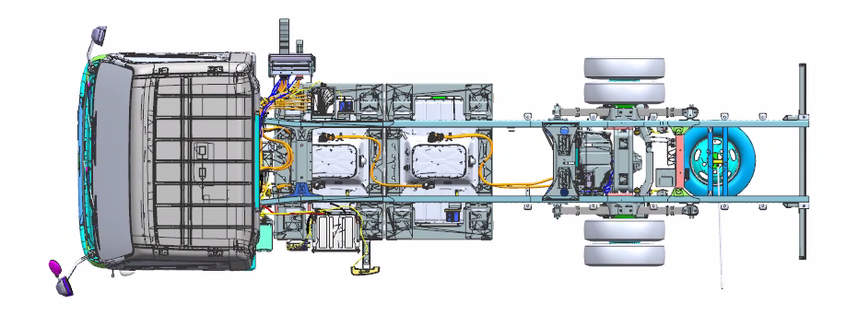
ELEKTRICKÁ JAZDA S eCANTER JE EFEKTÍVNA
TOK ENERGIE
Tok energie
Tok energie počas jazdy
1
2
3
1
1. HV batérie
2. Power Distribution Unit
3. eDrive Module (eDM)
Inverter + eMotor
Notes:
When Charging
When Driving
When Regenerating
Regenerative braking is an energy recovery mechanism that slows down a moving vehicle or object by converting its kinetic energy into electrical power that charges the vehicle’s high voltage battery.
In this mechanism, the electric motor uses the vehicle's momentum to recover energy that would otherwise be lost to the brake discs as heat.
This method contrasts with conventional braking systems. In those systems, the excess kinetic energy is converted to unwanted and wasted heat due to friction in the brakes.
Principle of Operation
1. When braking starts, the electric motor changes its operating mode: instead of being powered by a battery, it starts to work as a generator, generating energy (similar to a light generator on a bicycle). At this moment, opposite currents appear in the rotor and stator windings of the electric motor.
2. The decrease in the speed of the vehicle occurs because a braking torque appears on the shaft of the electric motor.
3. The kinetic energy available before the start of braking is transformed into electrical and thermal energy.
4. The emerging additional electricity flows into the battery, thereby increasing its charge.
When more braking torque is required than the generator alone can provide, additional braking is accomplished by friction brakes.

Slide 15
ELEKTRICKÁ JAZDA S eCANTER JE EFEKTÍVNA
Tok energie
Tok energie
Tok energie počas rekuperácie
1
2
3
1
1. HV Batteries
2. Power Distribution Unit
3. eDrive Module (eDM)
Inverter + eMotor
Notes:
When Charging
When Driving
When Regenerating
Regenerative braking is an energy recovery mechanism that slows down a moving vehicle or object by converting its kinetic energy into electrical power that charges the vehicle’s high voltage battery.
In this mechanism, the electric motor uses the vehicle's momentum to recover energy that would otherwise be lost to the brake discs as heat.
This method contrasts with conventional braking systems. In those systems, the excess kinetic energy is converted to unwanted and wasted heat due to friction in the brakes.
Principle of Operation
1. When braking starts, the electric motor changes its operating mode: instead of being powered by a battery, it starts to work as a generator, generating energy (similar to a light generator on a bicycle). At this moment, opposite currents appear in the rotor and stator windings of the electric motor.
2. The decrease in the speed of the vehicle occurs because a braking torque appears on the shaft of the electric motor.
3. The kinetic energy available before the start of braking is transformed into electrical and thermal energy.
4. The emerging additional electricity flows into the battery, thereby increasing its charge.
When more braking torque is required than the generator alone can provide, additional braking is accomplished by friction brakes.

Slide 16
ELEKTRICKÁ JAZDA S eCANTER JE EFEKTÍVNA
ONE-PEDAL DRIVING - použitie
Normálna jazda vpred
Pri približovaní k prekážke a svetelnej signalizácii
Je nutné odskúšanie na zistenie brzdného účinku a dráhy na spomalenie, resp. zastavenie
Jemné uvoľnenie plynového pedálu na plynulé zastavenie
Notes:
One-Pedal driving works with B3 – Strong brake mode
Before using One-Pedal Driving in traffic or on highways, practice using this feature in an empty parking lot or other safe area.
Once you get comfortable with accelerating, slowing and stopping the vehicle, you’ll be ready to take it on the road.

Slide 17
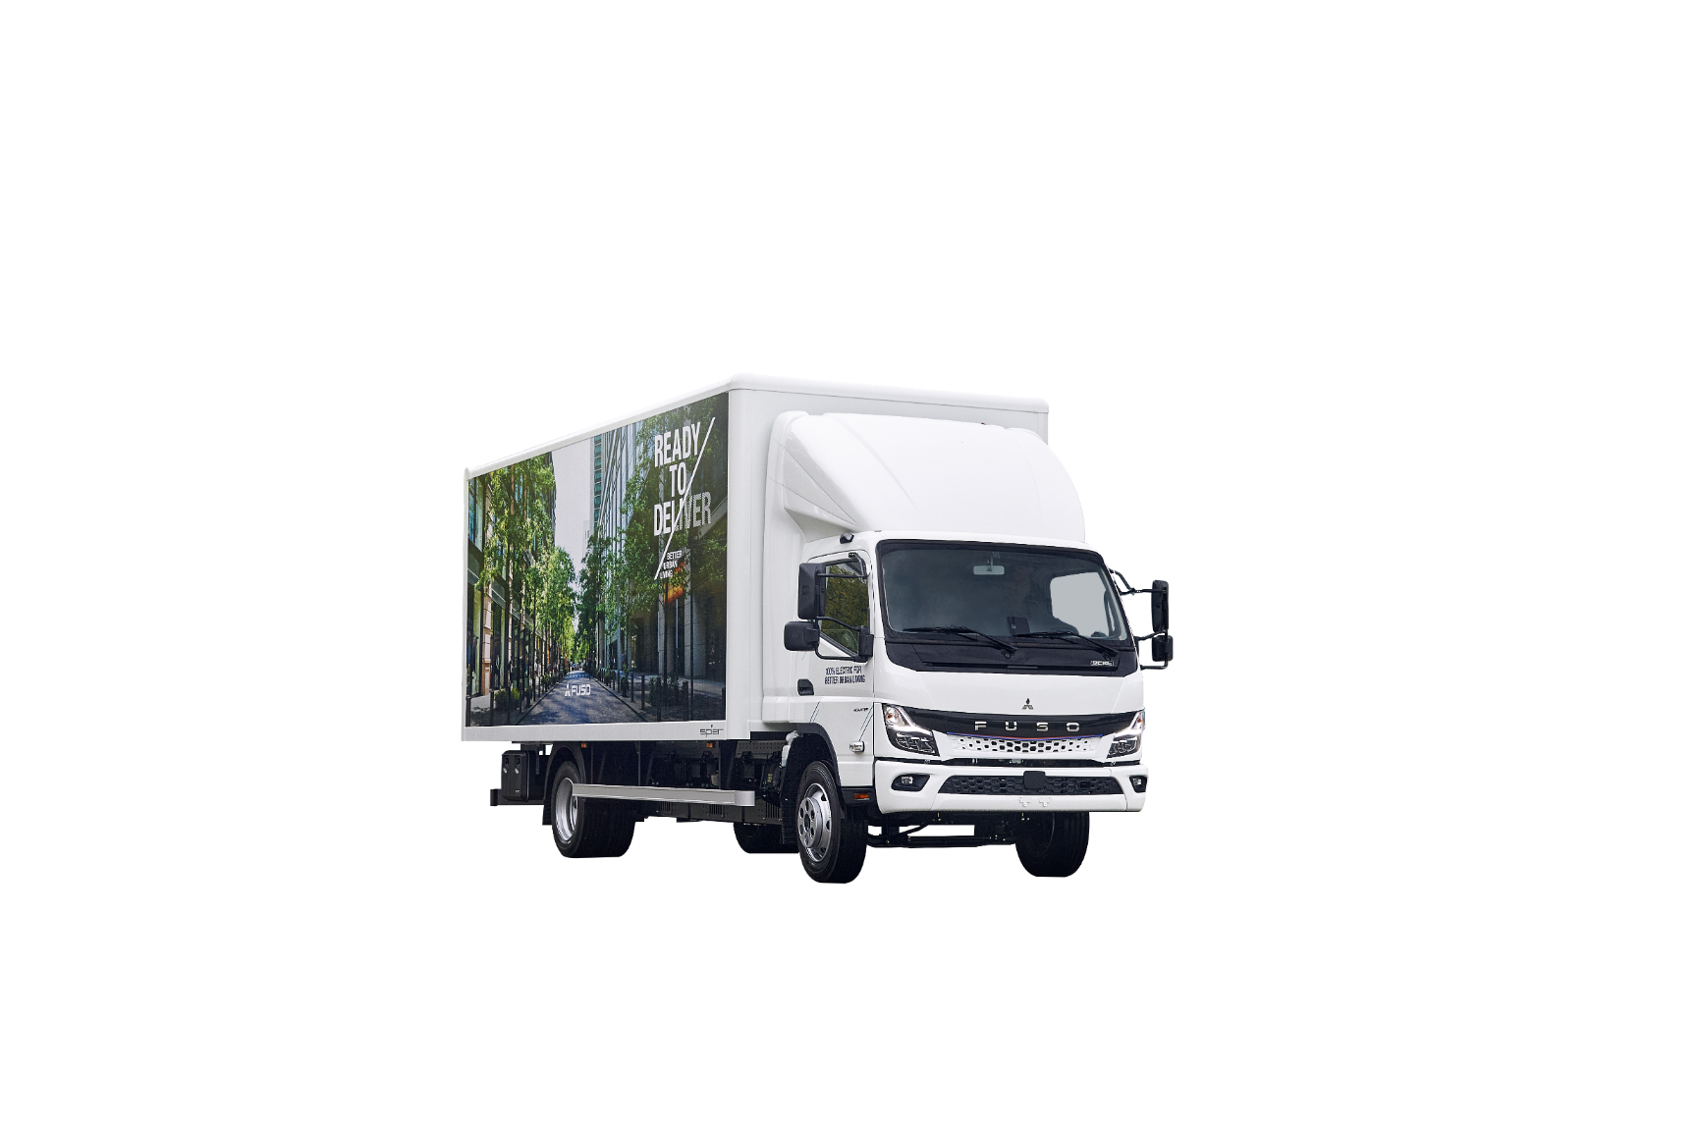
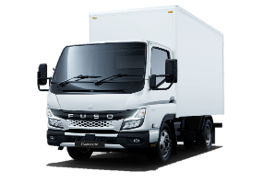
ELEKTRICKÁ JAZDA S eCANTER JE EFEKTÍVNA
eCANTER EFEKTIVITA – porovnanie energií
NO REGENERATIVE BRAKING USED – “SAILING MODE” B0
Consumption:
Estimated Range:
eCANTER 4C15e 110kW (150hp)
CANTER 3C15 110kW (150hp)
+83%
~10.5 l/ 100 km
~56 kWh/ 100 km
converted¹: 102.9 kWh/ 100km
>> 1.79 km / kWh
>> 0.97 km/ kWh
1) Výhrevná hodnota1l nafty je 9.8 kWh
Notes:
Irrespective of the driving style – the EV has a distinctive total energy advantage:
Comparing the heating value / calorific value of 1L Diesel, which corresponds to 9.8 kWh
And converting the reference consumption of a current Diesel Canter 3.5t (which is per se not inefficient)
To the eCanter, and comparing them on a km/ kWh input basis – the eCanter is significantly more efficient and can product more travel distance with less total energy input
>> The main message is an electric vehicle is significantly more energy efficient compared to the combustion engine
>> While eCanter needs 56kWh for 100km, the Diesel counterpart would need an equivalent of 102.9 kWH energy
There are multiple reasons:
Electric motors are more efficient than combustion engines (lower degree of efficiency)
Part of the energy generated during combustion is lost
eCanter can regenerate brake energy, which is lost at combustion vehicle energy balance I reducing the actual consumption of the eCanter (+/-.)
In terms of renewable energy generation, this factor can be neglected
Depending on the local electricity costs / diesel costs this efficiency advantage can turn into a cost advantage.

Slide 18
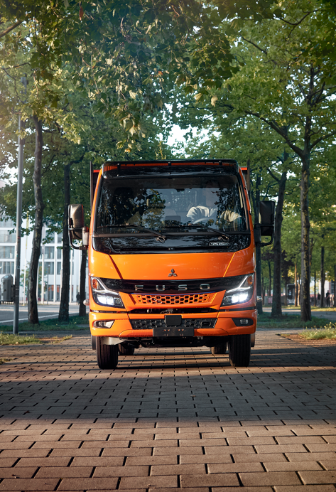
ELEKTRICKÁ JAZDA S eCANTER JE EFEKTÍVNA
TYPY NA PREDĹŽENIE DOJAZDU
Vyhýbajte sa rýchlym štartom, prílišnej akcelerácii a panickému brzdeniu. Nápomocné vám bude znázornenie ECO zóny na displeji
Sledujte situáciu na ceste a prispôsobte brzdenie plynulej jazde.
Zžite sa s rekuperačným brzdením
Pravideľne kontrolujte tlak v pneumatikách. Podhustené pneumatiky negatívne vplývajú na dojazd vozidla
Ukladajte prepravovaný tovar tak, aby nezvyšoval jazdný odpor vzduchu. Vždy maximálne redukujte koeficient odporu vzduchu
Notes:
As we think those things are relevant for all eDrivers, we are launching an Driver Training for eCanter
> theoretical and practical part for the drivers to get to know the technology
> Analyze their driving and optimize it for EV

Slide 19

NEXT GENERATION eCANTER DRIVING EXPERIENCE |
WORKSHOP OVERVIEW
eMOBILITA
VLASTNOSTI
FLEXIBILITA
EFEKTÍVNOSŤ
Hlavné atribúty:
Elektromobilita prekonala veľký rozvoj.
FUSO má veľké skúsenosti s electromobilitou.
FUSO je seriózny partner pre eMobilitu.
Obsah:
Technológia batérií
Možnosti nabíjania
Electrive Drive Module
eTruck Ready Route Analysis
Zníženie CO2
Hlavné atribúty :
Vozidlo je vhodné na použitie v zastavaných mestských oblastiach, dokonca ešte vhodnejšie ako naftový Canter, a je aj bezpečné
Obsah :
Manévrovateľnosť
Ochrana batérií
Dobrá viditeľnosť
Bezpečnostné prvky, napr. ABA5
Hlavné atribúty :
FUSO má ten správny produkt a dokáže pokryť moje prepravné požiadavky
(FUSO ukazuje aktuálne vývoj v oblasti etrucking)
Obsah :
Rôzne varianty
Balíčky aplikačných výbav
Aplikácie nadstavieb,napr. mPTO
Ecosystem
Servisné zmluvy
Hlavné atribúty :
Jazda s elektrickým vozidlom je efektívna, komfortná a jednoduchá
Vývoj od Canter k eCanter dôkazom kvalitného produktu po všetkých stránkach
Obsah :
Rekuperačný modus
Hladká jemná jazda
Vylepšený displej a interiér
Jednoduchý proces nabíjania

